Slide 1
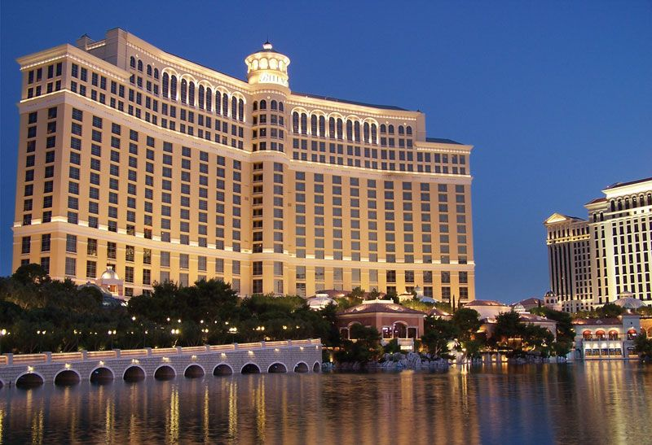
HOTEL AGGREGATOR ANALYSIS
Power bi visualization
By
G swaroop

Slide 2
Table of Contents
Problem Statement
Project Objectives
Key Insights
Recommendation

Slide 3
Problem Statement
This project aims to analyse a dataset of hotel aggregator listings using Power BI . The dataset comprises various attributes related to listings, hosts, reviews, and availability. The objective Is to create comprehensive visualizations and insights that’ shed light on trends, patterns, and factors influencing the performance of listings.

Slide 4
Project Objectives:
1. Geographical Insights:
- Visualize the distribution of listings on a map to identify popular neighbourhoods.
- Explore the geographical concentration of listings and host locations.
2. Pricing and Availability Analysis:
- Analyse pricing trends based on property types, room types, and accommodation capacity.
- Investigate the availability of listings over time and identify peak periods.
3. Host Performance:
- Evaluate host characteristics, including superhost status, response times, and verification methods.
- Explore correlations between host attributes and listing performance.
4. Review Scores and Guest Satisfaction:
- Examine review scores and their impact on overall listing performance.
- Identify areas for improvement based on specific review categories.
5. Property Type and Room Analysis:
- Analyse the distribution of property types and room types.
- Explore trends in the popularity of specific accommodation setups.

Slide 5
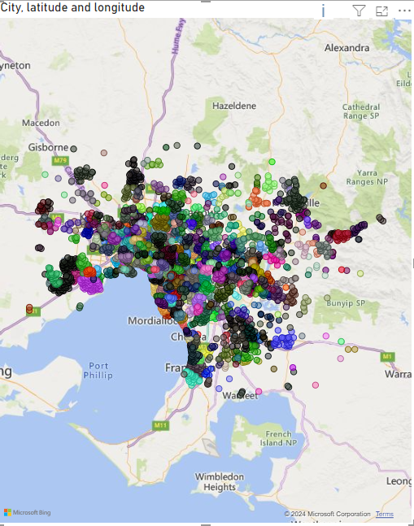
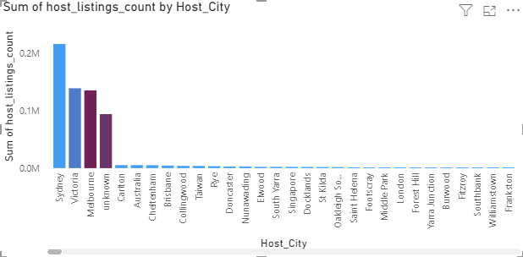
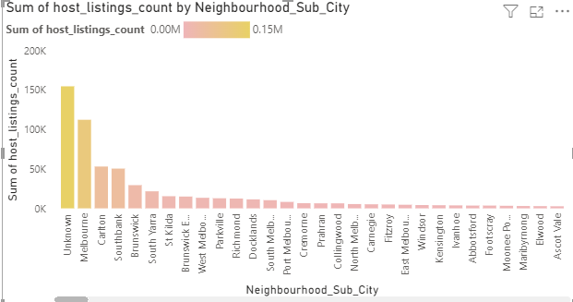
Geographical insight

Slide 6
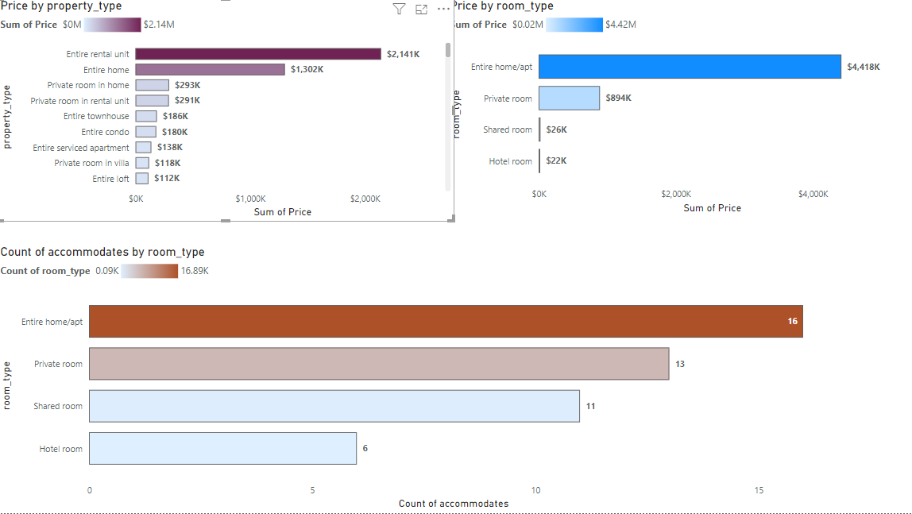
Pricing and Availability Analysis:

Slide 7
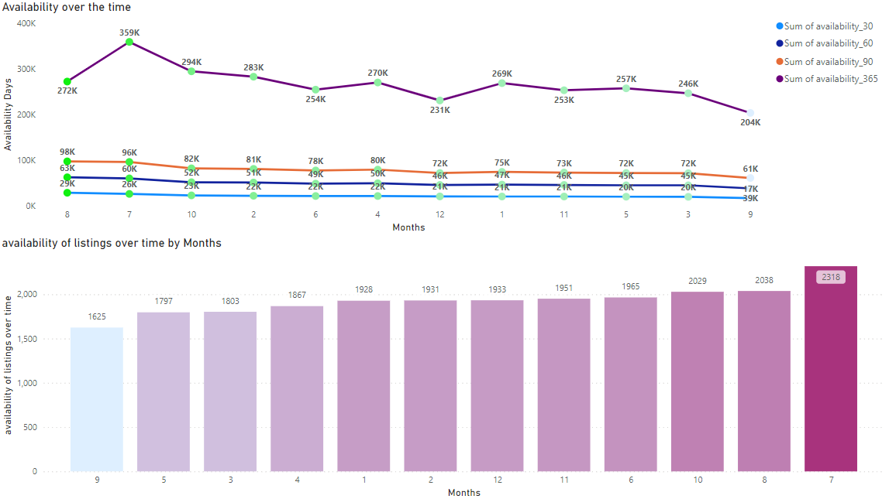
Host Performance

Slide 8
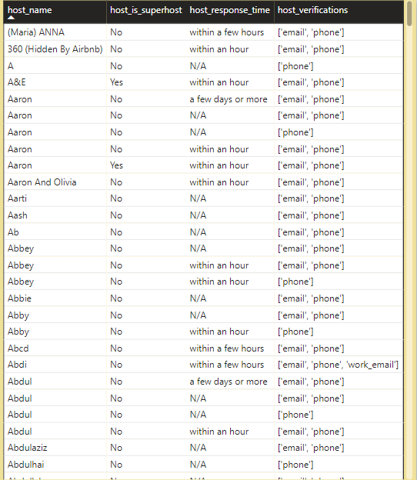
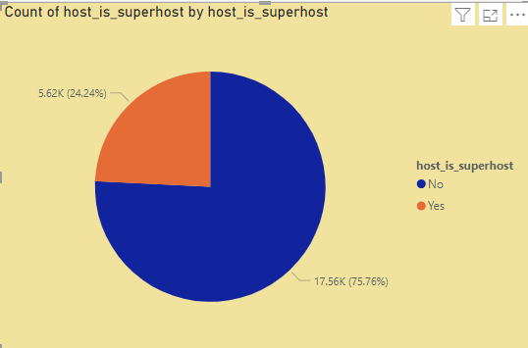
Review Scores and Guest Satisfaction

Slide 9
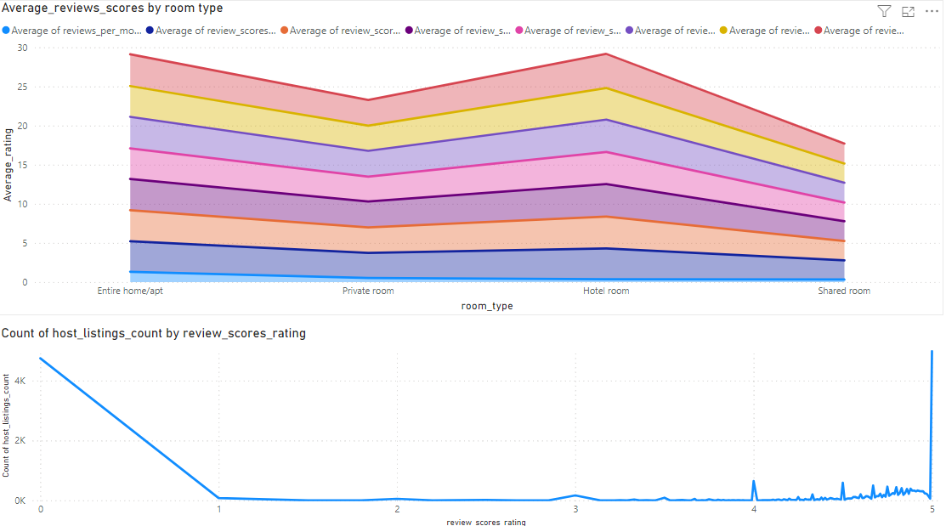
Review Scores and Guest Satisfaction

Slide 10
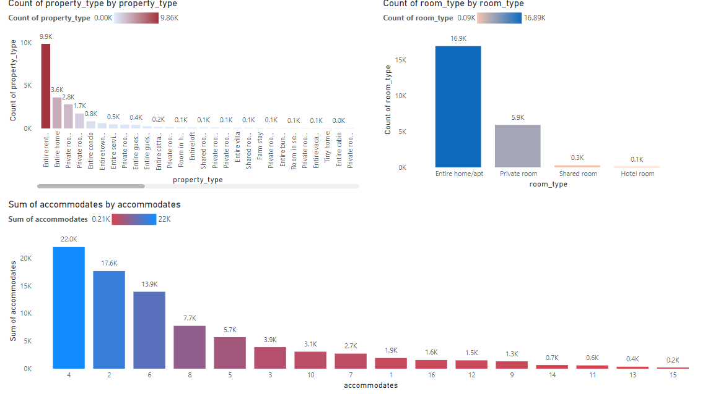
Property Type and Room Analysis

Slide 11
Recommendation
Host Performance Optimization:
Encourage hosts to maintain quick response times to enhance guest satisfaction.
Promote the use of multiple verification methods to build trust with guests.
Consider the benefits of achieving super host status for improved credibility.
Pricing and availability Strategies:
Analyse pricing trends for different property and room types to set competitive rates.
Adjust pricing based on accommodates to maximize revenue and occupancy.
Monitor availability to capitalize on high-demand periods and adjust pricing accordingly.

Slide 12
Recommendation
Guest Satisfaction Enhancement:
Focus on improving review scores by providing exceptional service and amenities.
Track guest satisfaction levels over time to identify areas for improvement.
Tailor property and room offering to meet guest preferences and enhance satisfaction
Property and Room Type Management
Understand the popularity of different property and room types t optimize inventory.
Diversify offering based on demand for specific accommodation options.
Utilize insight to enhance marketing strategies and target relevant customer segements.

Slide 13
Thank you..

